Slide 1

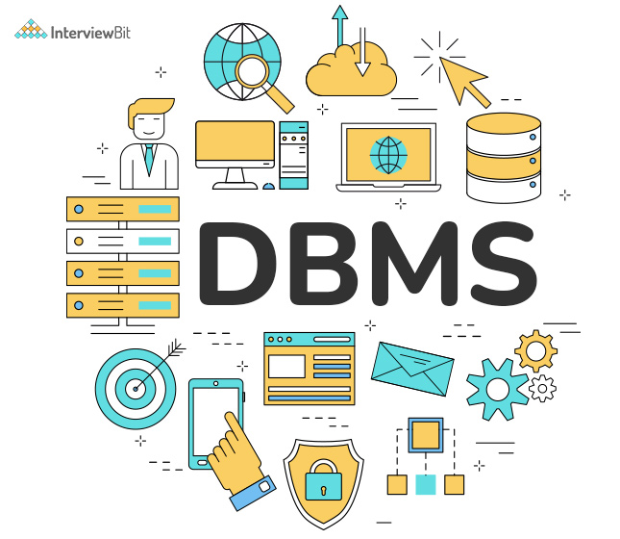
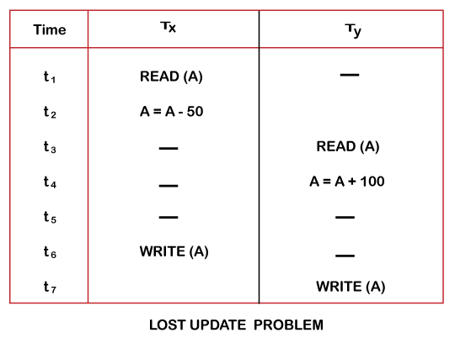
Topic Name:Transaction and Concurrency
Presented by
Akanksha Singh
MCA(2022-25)
Dept. Of Computer Application
National institute of technology Tiruchirappalli
Roll No - 205122008
Under the guidance of
Dr. S. Nickolas and Ms.Pakhiya
Dept. Of Computer Applications
National institute of technology Tiruchirappalli
(NIT Trichy)

Slide 2
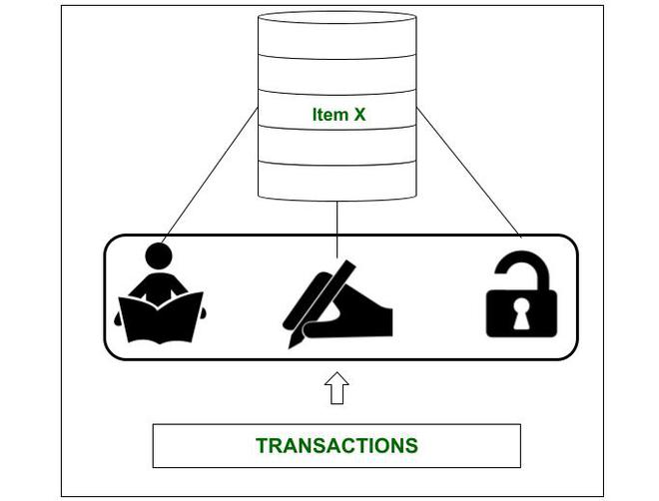
Table of Contents
Definition
Why MYSQL necessary for Transaction ?
Properties of the Transaction
Concurrent vs Parallel Transaction
Schedule
Problems due to Concurrency
Concurrency Protocol
Practice Problem of Transaction

Slide 3
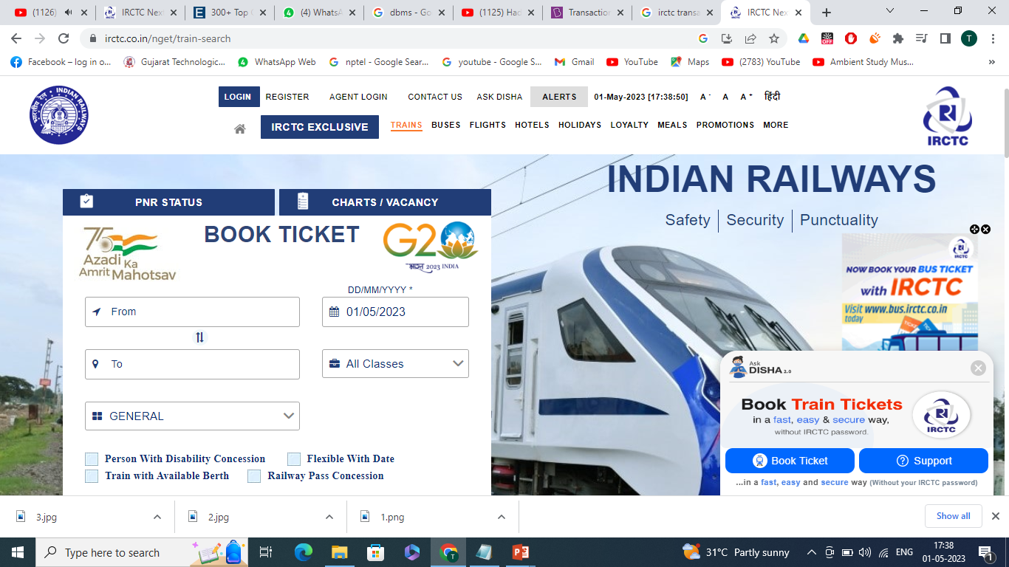
What is Transaction?
We can define a transaction as a group of tasks in DBMS. Here a single task refers to a minimum processing unit, and we cannot divide it further.
Now let us take the example of a certain simple transaction. Suppose any person wants to book a ticket from Delhi to Trichy.
Steps to Perform Transaction:
Step 1: Person Open IRCTC’s website.
Step 2: Do Login to His/hers Account.
Step 3: Choose a Date, Source, Destination , etc.
Step 4: Search a Train Accordingly.
Step 5: Choose A train
Step 6: Book a Seat based on Availability
Step 7: Payment
Step 8: Finish

Slide 4
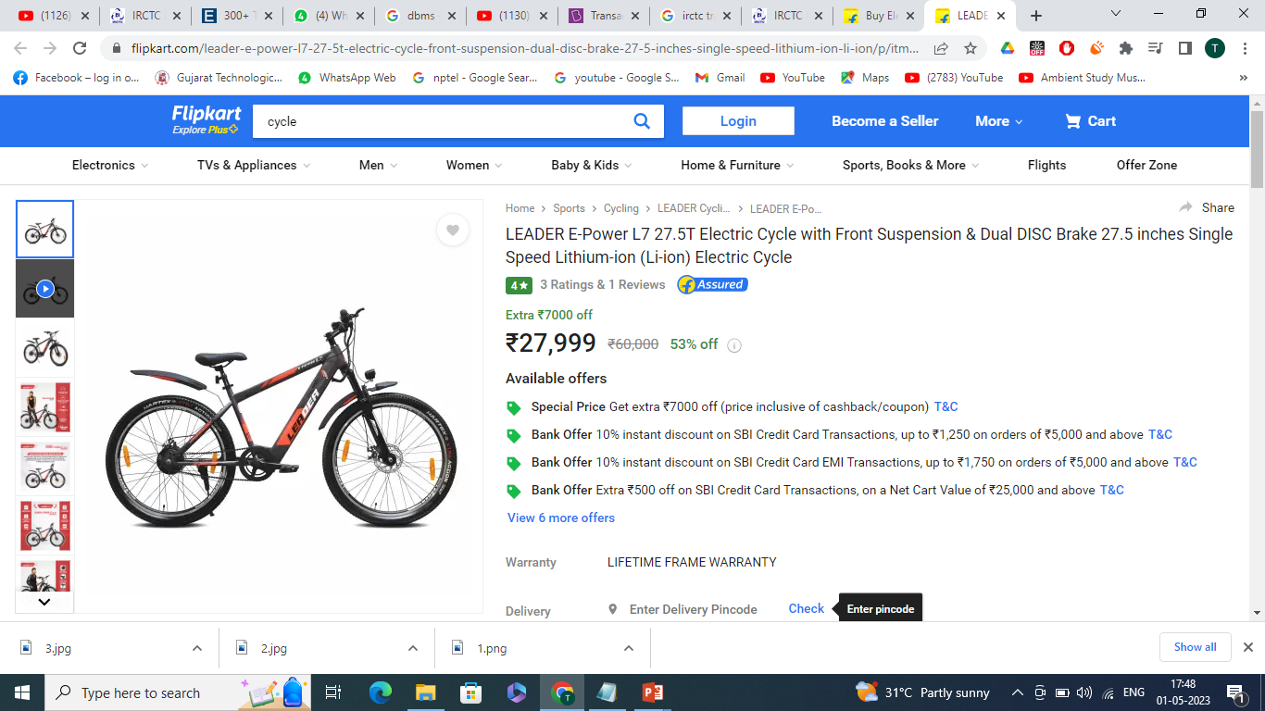
Why MYSQL necessary for Transaction ?
In Today’s era Enterprise like flipkart,Amazon,Snapdeal use No-SQL but still MYSQL is really important . Why ?

Slide 5
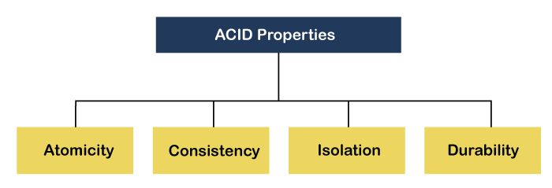
Properties of the Transaction

Slide 6
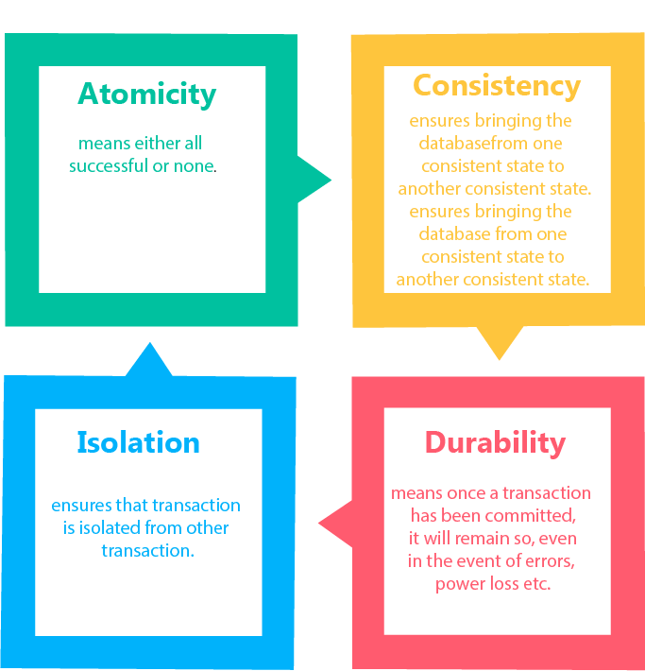

Slide 7
1. Atomicity
The property of atomicity states that we must treat any given transaction as an atomic unit. It means that either all or none of its operations need to be executed.
2. Consistency
The property of consistency states that the database must always remain in a consistent state after any transaction.
3. Durability
The property of durability states that any given database must be durable enough to all of its latest updates, and it must happen even if the system suddenly restarts or fails
4. Isolation
The property of isolation states that when multiple transactions are being simultaneously executed and in parallel in a database system, then the carrying out and execution of the transaction would occur as if it is the only transaction that exists in the system. None of the transactions would affect any other transaction’s existence.

Slide 8
What is Schedule?
A series of operation from one transaction to another transaction is known as schedule.
It is used to preserve the order of the operation in each of the individual transaction.
Schedule
T1
MYSQL/ORACLE
T1,T3,T4,T2,T1,T2
T2
T2,T4,T3,T1,T4,T3
T1,T4,T2,T3,T2,T1
T3
T2,T3,T4,T1,T3,T4
T4
T1,T2,T3,T4,T3,T1

Slide 9
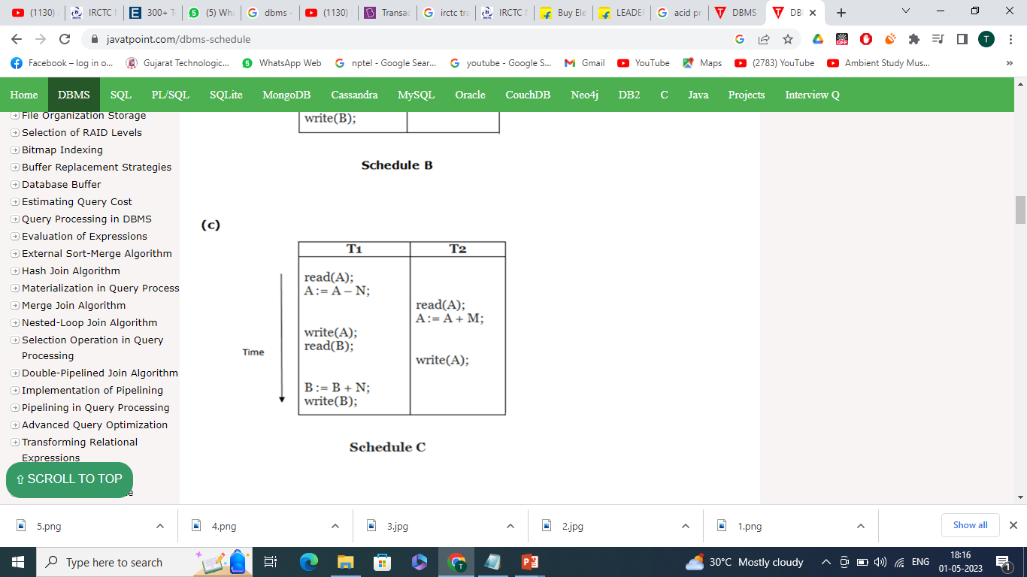
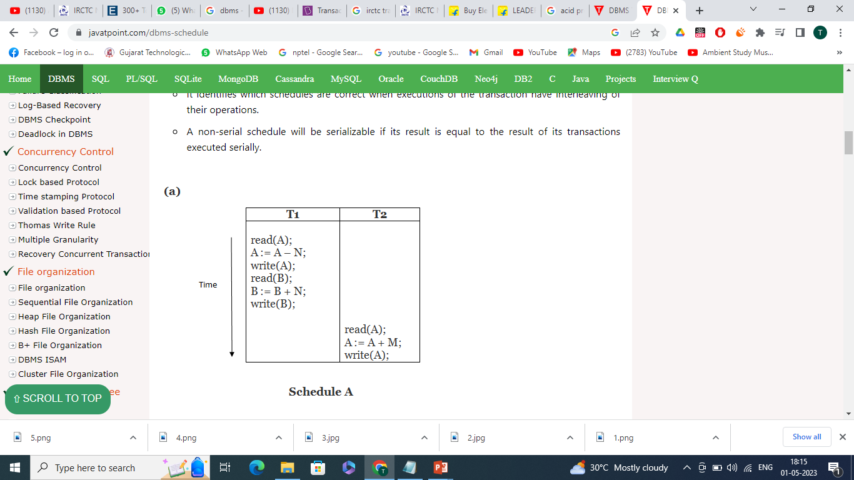
Serial Schedule vs Non-Serial Schedule
Serial Schedule
Non- Serial Schedule

Slide 10

Why Non-Serial Schedule ?

Slide 11
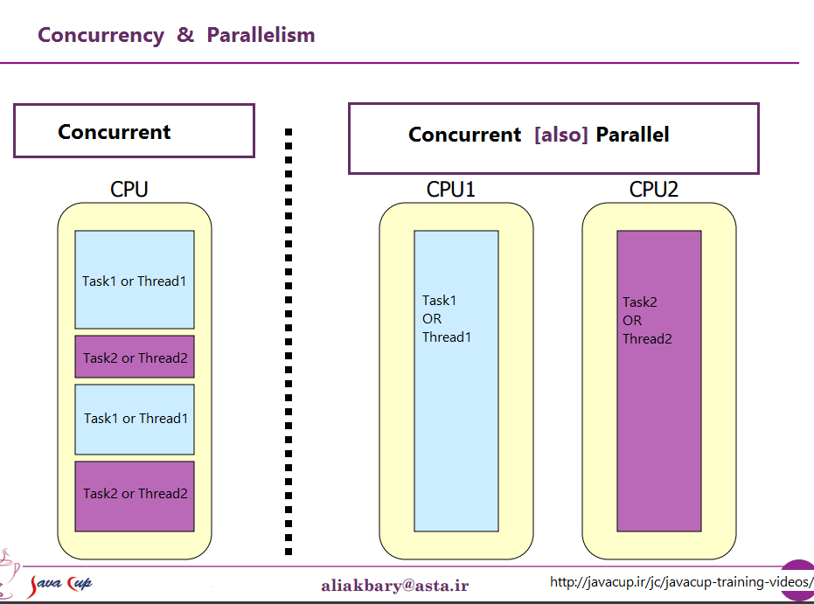
Concurrency vs Parallelism

Slide 12
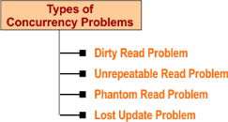
Problems due to Concurrency

Slide 13
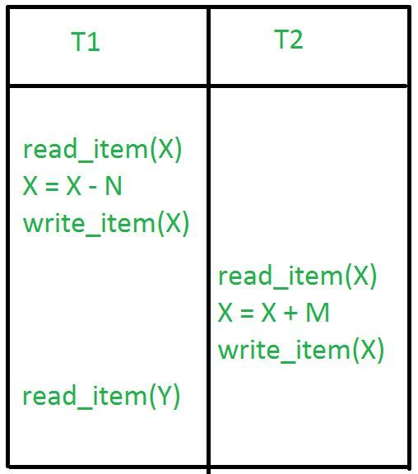
1.Dirty Read Problem

Slide 14
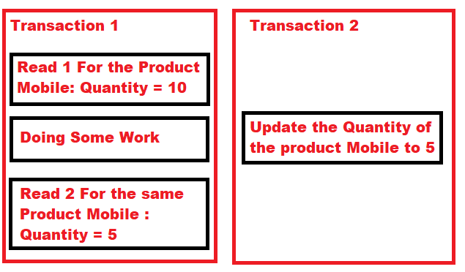
2.Unrepeatable Read Problem

Slide 15
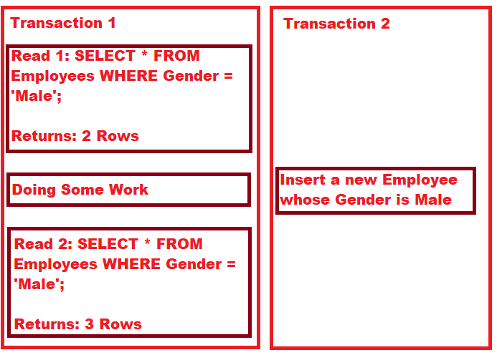
3.Phantom Read Problem

Slide 16
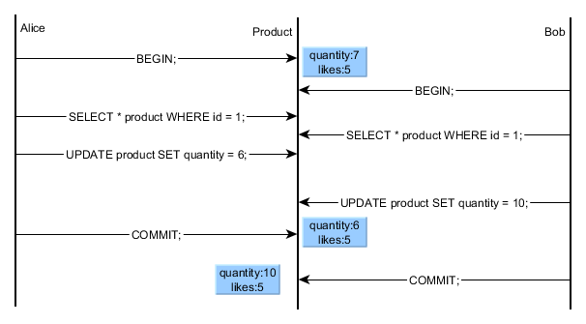
4.Lost Update Problem

Slide 17
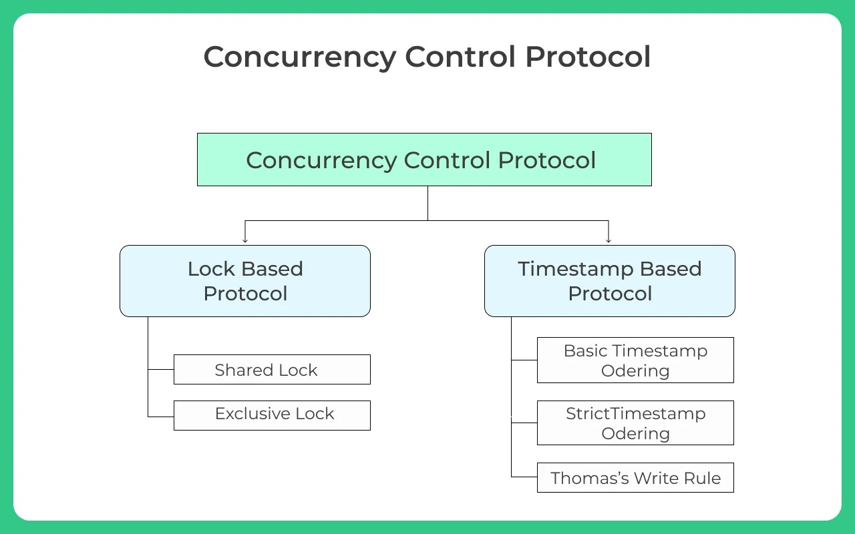
Concurrency Protocol

Slide 18
Practice Problems of Transaction
1. A transaction that completes its execution is known to be:
a. Loaded
b. Saved
c. Committed
d. Rolled
2. We can change the deadlock state back to a stable state using the _ statement.
a. Rollback
b. Commit
c. Deadlock
d. Savepoint
3. What are the four ACID properties of a transaction in DBMS?
a. Atomicity, Consistency, Inconsistent, Durability
b. Atomicity, Consistency, Isolation, Database
c. Automatically, Concurrency, Isolation, Durability
d. Atomicity, Consistency, Isolation, Durability

Slide 19
Thank You

